Slide 1
Foundations 201
Week 6
Do we find goodness in power?
[Philosophy, Politics, Psychology and Research]

Slide 2
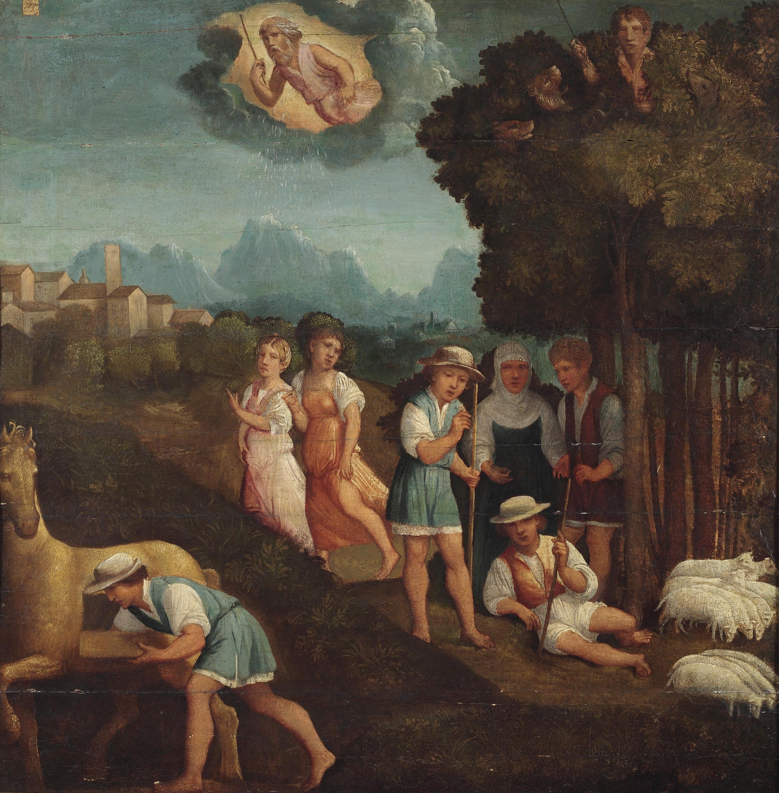
Plato’s Republic – Ring of Gyges
Gyges was a shepherd in the service of the king of Lydia; there was a great storm, and an earthquake made an opening in the earth at the place where he was feeding his flock. Amazed at the sight, he descended into the opening, where, among other marvels, he beheld a hollow brazen horse, having doors, at which he stooping and looking in saw a dead body of stature, as appeared to him, more than human, and having nothing on but a gold ring; this he took from the finger of the dead and rescinded.
Now the shepherds met together, according to custom, that they might send their monthly report about the flocks to the king; into their assembly he came having the ring on his finger, and as he was sitting among them he chanced to turn the collet of the ring inside his hand, when instantly he became invisible to the rest of the company and they began to speak of him as if he were no longer present. He was astonished at this, and again touching the ring he turned the collet outwards and reappeared; he made several trials of the ring, and always with the same result—when he turned the collet inwards he became invisible, when outwards he reappeared.
Notes:
Have students read this section of the Republic, then respond to these questions:
What other stories does this remind you of?
Would you like to have a ring similar to this? Why – Why not?
What would you want to do if you had such a ring?
What will the shepherd choose to do next?
Image: “Der Ring des Gyges.” Anonymous. 16th C. https://commons.wikimedia.org/wiki/File:Der_Ring_des_Gyges_(Ferrara_16_Jh).jpg

Slide 3
Plato’s Republic – Ring of Gyges
Whereupon he contrived to be chosen one of the messengers who were sent to the court; whereas soon as he arrived he seduced the queen, and with her help conspired against the king and slew him, and took the kingdom.
Suppose now that there were two such magic rings, and the just put on one of them and the unjust the other; no man can be imagined to be of such an iron nature that he would stand fast in justice. No man would keep his hands off what was not his own when he could safely take what he liked out of the market, or go into houses and lie with any one at his pleasure, or kill or release from prison whom he would, and in all respects be like a God among men. Then the actions of the just would be as the actions of the unjust; they would both come at last to the same point.
Notes:
Have students read this section of the Republic, then respond to these questions:
Did the shepherd’s actions surprise you?
Do you agree that every person would be unethical, given the abilities of a ring of Gyges?

Slide 4
Plato’s Republic – Ring of Gyges
And this we may truly affirm to be a great proof that a man is just, not willingly or because he thinks that justice is any good to him individually, but of necessity, for wherever any one thinks that he can safely be unjust, there he is unjust. For all men believe in their hearts that injustice is far more profitable to the individual than justice, and he who argues as I have been supposing, will say that they are right.
If you could imagine any one obtaining this power of becoming invisible, and never doing any wrong or touching what was another's, he would be thought by the lookers-on to be a most wretched idiot, although they would praise him to one another's faces, and keep up appearances with one another from a fear that they too might suffer injustice.
Notes:
Have students read this section of the Republic, then respond to these questions:
Is it through the pressures of society that we choose to act justly, or through the strength of our own ethics?
Can you truthfully say that with the power of a ring of Gyges you would not be unethical, even in a very small way?
What of Plato’s critique of those who claim they would do no injustice?

Slide 5
Sources:
Plato. The Republic. Translated by Benjamin Jowett. e-book, pp. 235-236. Project Gutenburg, 2008. http://www.gutenberg.org/ebooks/1497
Rickards, Bill. "Republic by Plato." Salem Press Encyclopedia of Literature, January. EBSCOhost, http://search.ebscohost.com/login.aspx?direct=true&db=ers&AN=87575252&site=eds-live.
Satris, Stephen. "Plato." Salem Press Biographical Encyclopedia, January. EBSCOhost, http://search.ebscohost.com/login.aspx?direct=true&db=ers&AN=88258842&site=eds-live.
Satris, Stephen. "Socrates." Salem Press Biographical Encyclopedia, January. EBSCOhost, http://search.ebscohost.com/login.aspx?direct=true&db=ers&AN=88258906&site=eds-live.

